Slide 1
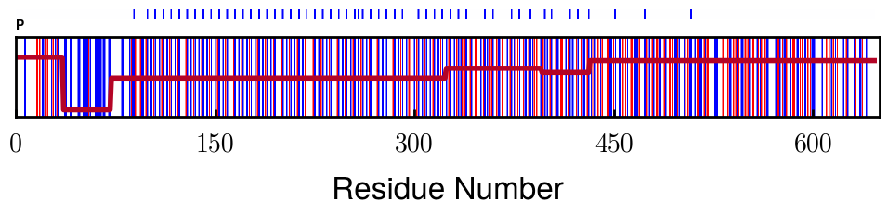
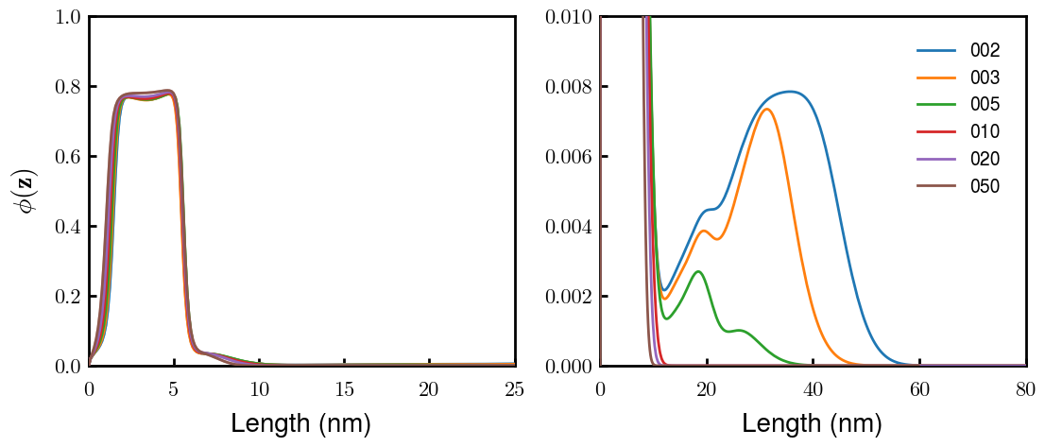
Original: phosphorylated NFH (-1.5e) at 7.44 pH
Ionic Strength (mM)

Slide 2
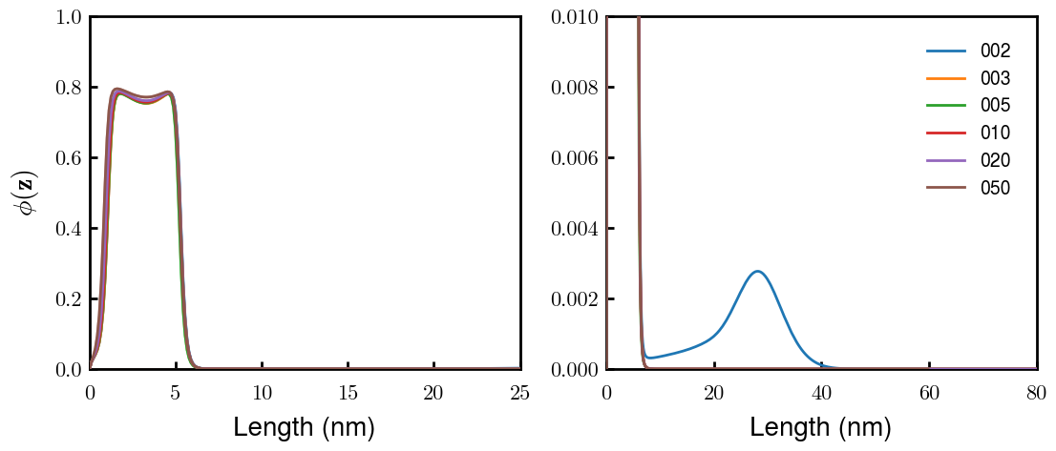
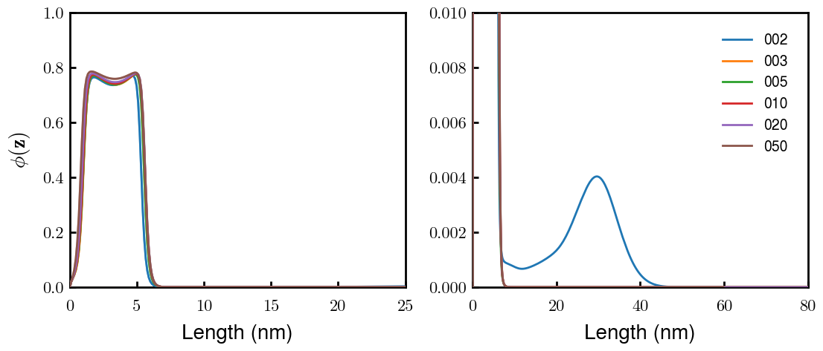
Original (647 AA length)
p0NFH: Take out Block 2 (611 AA length)
p1NFH: Neutral Block 2 (647 AA length)
Note: charge distributions figures made in ppt but reflect the changes accurately

Slide 3
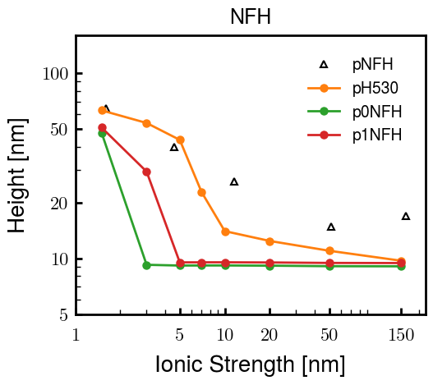
Original
Note: b and v values still being tuned (but is consistent between results in this figure)
Will update again with better original fit b/v’s

